Slide 1
Model on Oregon Housing Prices
By Steve Rodriguez

Slide 2
Why?
Estimate current/future house pricing
What factors sway the price the most
There has already been talks in the economic community regarding housing prices, this is a good way to apply it to Oregon
Yener Coskun in Turkey and Md Abdullah Al-Masum in Western Sydney U
Notes:
Housing in turkey: found evidence that there is a long term correlation between house price index, house rent, construction cost, and real mortgage interest rate.
Show us that they found that monetary variables played a large part.
Gross disposable income, housing supply, UR, GDP are the key determinants of Sydney housing prices

Slide 3
What do I expect?
My dependent variable - Property Value (Dollars)
Independent variables -
Household Income (Dollars)
Travel time to work (Minutes)
Lot size (Acres)
PropertyValue = β₀ + β₁HHI - β₂TTW + β₃LS

Slide 4
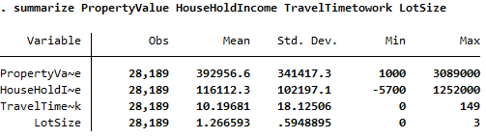
Data Dump - Gathered by PUMS
Notes:
Mention data fixing
Census Data - 2018 ACS 1 Year

Slide 5
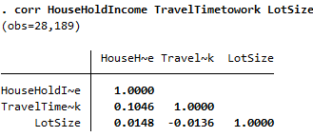
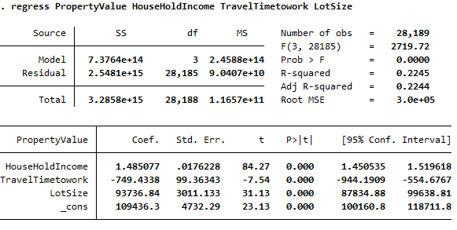
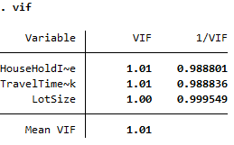
Standard Regression
PropertyValue = 109436.30 + 1.48HHI - 749.43TTW + 93736.84LS
Notes:
Explain coefficients
R^2
They came out as I expected

Slide 6
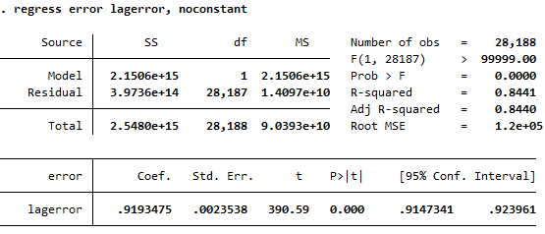
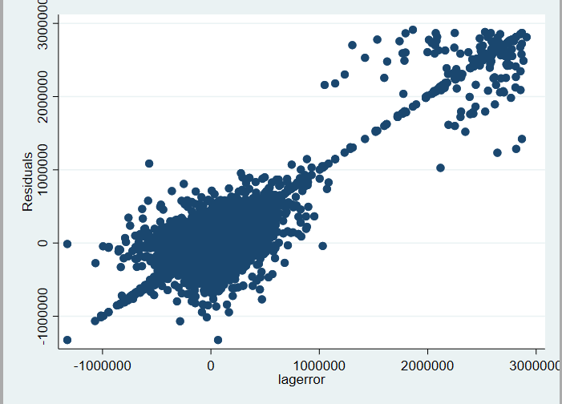
Multicollinearity - Not seen
Serial correlation - not possible?
Not time series?
Probably due to OV

Slide 7
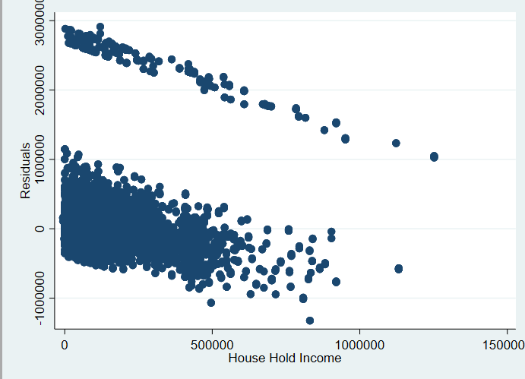
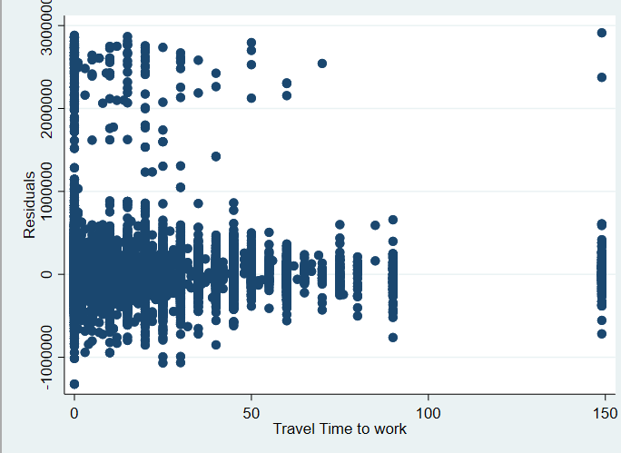
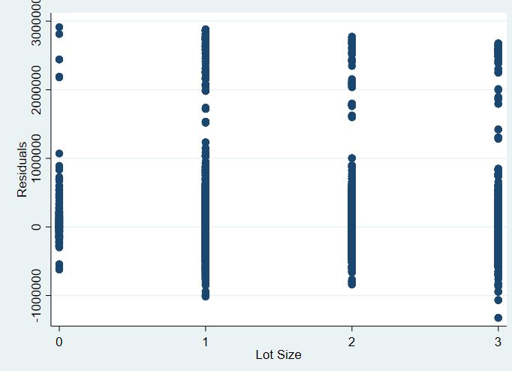
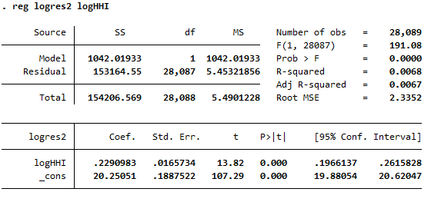
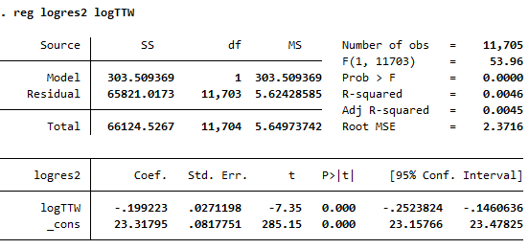
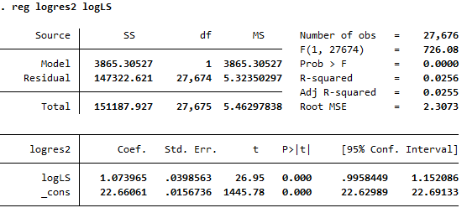
Heteroskedasticity - Detection

Slide 8
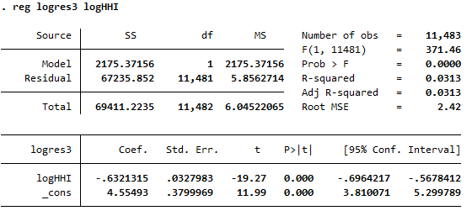
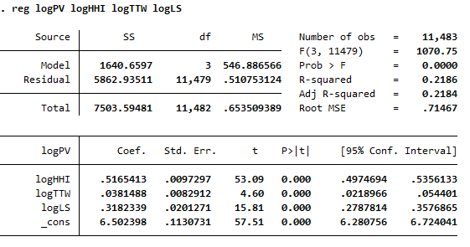
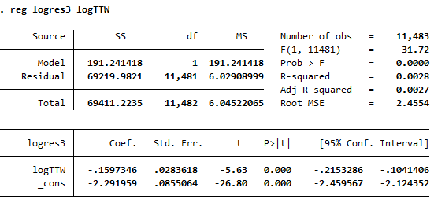
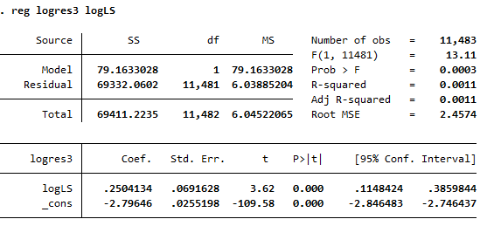
Heteroskedasticity - Remedies
Double-log form

Slide 9
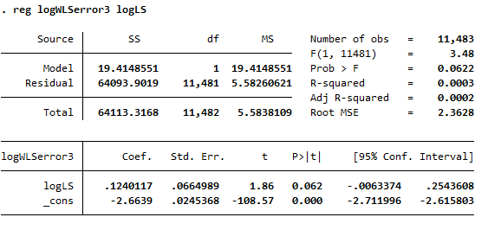
Continued Heteroskedasticity remedies
Tried all independent variables on the WLS, correcting them anyway with the robust command on the original model and the double log model.
Only one that was able to pass the parks test
→ [aweight=1/logLS]

Slide 10
Conclusion
Major problems with a missing variable.
Seen in the Serial correlation assumption and the Heteroskedasticity assumption.
Although the first model gives us an equation that we like, when we check for assumptions it violates a lot of them.

